Slide 1

ITA1409 – Ethical Hacking
Capstone Project Review
LinkReveal : Secure URL Expander with Threat Detection and
Network Security Analysis
Presented By:
S. Harichandana(192372136)
B. Yasritha(192312348)
N Mokshitha(192411085)
P. Amrutha(192372359)
Guided By:
Dr Ruby Elizabeth
Professor , SIMATS Engineering

Slide 2


Abstract
LinkReveal is a web-based tool designed to expand shortened URLs and detect potential online threats. It reveals the final destination of a URL and identifies suspicious redirects. The system analyzes URL structures, domain information, and suspicious patterns to detect potential phishing and malicious links. It also performs basic network security analysis to assess website risks. Based on the analysis, it classifies URLs as Safe, Suspicious, or Malicious and displays the results and security warnings through a simple, user-friendly interface.

Slide 3
Introduction
Shortened URLs often hide their actual destination, making it difficult for users to identify potentially dangerous websites.
Cybercriminals use suspicious links to conduct phishing attacks, distribute malware, and steal sensitive information.
LinkReveal is a web-based security tool designed to analyze URLs and help users identify potential online threats.
It expands shortened URLs, traces redirects, and examines website information through DNS resolution.
The system uses security checks to assess URL risks and provide useful information before users visit unknown websites.

Slide 4
Problem Statement
Shortened URLs and suspicious links often hide their actual destination, making it difficult for users to identify potential threats.
Cybercriminals use malicious links to conduct phishing attacks, spread malware, and steal sensitive information.
Many users open unknown links without verifying their authenticity or security.
There is a need for a simple tool that can expand shortened URLs, analyze redirects, and detect suspicious website characteristics.
LinkReveal aims to address this problem by analyzing URLs, identifying potential security threats, and providing clear warnings to help users make safer browsing decisions.

Slide 5
Objectives
To expand shortened URLs and reveal their actual destination links.
To detect suspicious URLs, phishing links, and potential malicious websites.
To analyze URL structures and redirect behavior to identify possible security threats.
To perform basic network security analysis of destination websites.
To classify URLs as Safe, Suspicious, or Malicious based on security checks.
To display clear warnings and analysis results through a user-friendly interface.
To improve user awareness and promote safe browsing practices.

Slide 6
Existing System
Existing URL-checking tools may only check whether a URL appears in known threat databases, without providing a complete analysis.
Shortened URLs can hide their actual destination, making it difficult for users to identify suspicious websites.
Some tools provide limited information about redirect chains, server IP addresses, and domain locations.
Users may not receive detailed security reports that combine different URL analysis results.
Users may find it difficult to identify potential phishing links and malicious websites before opening them.

Slide 7
Proposed System
Expands shortened URLs and traces HTTP redirects to identify the final destination website.
Uses Google Safe Browsing API to detect known phishing and malware threats with a three-second timeout.
Performs DNS resolution to obtain server IP addresses and uses RAM caching to improve lookup performance.
Retrieves approximate IP geolocation information and classifies URLs as Safe, Suspicious, or Malicious based on the analysis.
Provides a user-friendly web interface to display security reports and optionally stores analysis history in MongoDB.

Slide 8
Literature Review
SNO | Author Names | Year of Publication | Research Problem | Tools/ Technique Used | Research Gap
1 | Kumar, A., et al. | 2024 | Mobile Phishing & Threat Intelligence Logging | Centralized Cloud Databases, REST APIs | Compromises user privacy by storing scanned URLs centrally; lacks decentralized, on-device logging (AsyncStorage).
2 | Doe, J., & Patel, N. | 2023 | High Latency in Mobile URL Scanners | Cloud-based URL Scanners | High query latency on mobile networks; fails to implement backend in-memory RAM caching for repeated queries.
3 | Smith, T., & Lee, K. | 2022 | Unmasking Malicious URL Shorteners | Standard HTTP Requests, Client-side scripts | Vulnerable to dead-server timeouts causing client-side app crashes; lacks strict backend fail-fast mechanisms.
4 | Wang, Y., et al. | 2021 | Bypassing IP-based Firewalls in Scanners | Third-party DNS APIs, Proxy servers | Third-party APIs frequently block automated data center traffic; lacks native DNS resolution for raw IP extraction.

Slide 9
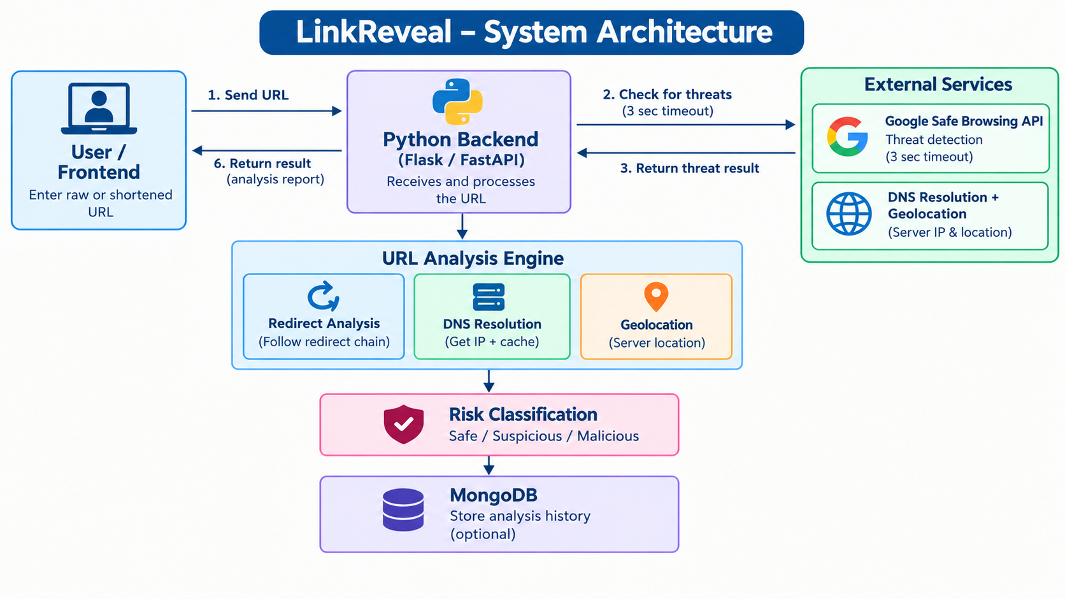
System Architecture

Slide 10
List of Modules
Module 1: URL Expansion and Redirect Analysis
Module 2: Threat Detection
Module 3: DNS Resolution and IP Geolocation
Module 4: Risk Classification and Report Generation

Slide 11
Module 1 : URL Expansion and Redirect Analysis
Expands shortened URLs to reveal the actual destination link and help users understand where the link leads.
Traces HTTP redirects from the original URL to the final destination website.
Identifies intermediate URLs involved in the redirection process before reaching the final destination.
Detects unexpected redirections that may indicate suspicious website behavior.
Displays the final destination URL for further security checks and threat analysis.
Helps users understand the complete redirection path before visiting an unknown website.
Provides the expanded URL as input for the next module to check for potential security threats.

Slide 12
Module 2 : Threat Detection
Uses the Google Safe Browsing API to check URLs against known phishing and malware threats.
Identifies URLs associated with phishing attacks, malware distribution, and other known online security threats.
Sends the expanded destination URL for security verification before users visit the website.
Uses a 3-second timeout to prevent the threat-checking process from waiting too long for a response.
Analyzes the API response to determine whether the URL matches any known security threats.
Provides threat detection results to support the risk classification process.
Helps users identify potentially dangerous links and make safer browsing decisions.

Slide 13
Module 3 : DNS Resolution and IP Geolocation
Resolves domain names into IP addresses to identify the server hosting the destination website.
Extracts the server IP address to support further network security analysis.
Uses RAM caching to store previous lookup results and improve response speed.
Retrieves approximate geographical information about the server using its IP address.
Helps users understand the server location associated with the destination website.
Reduces repeated DNS lookup operations through caching for faster analysis.
Provides IP address and geolocation details for the next module to classify the URL's risk level.

Slide 14
Module 4 : Risk Classification and Report Generation
Classifies analyzed URLs into three categories: Safe, Suspicious, or Malicious based on security analysis results.
Combines URL expansion, threat detection, DNS resolution, and IP geolocation details for risk assessment.
Identifies potential security risks using the results obtained from the previous modules.
Generates a security report containing URL analysis results and relevant website information.
Displays the final risk classification and security warnings through a user-friendly web interface.
Optionally stores URL analysis history in MongoDB for future reference.

Slide 15
Conclusion
LinkReveal expands shortened URLs and reveals their actual destination websites.
Detects potential phishing and malware threats using Google Safe Browsing API.
Analyzes DNS records, server IP addresses, and approximate geographical locations.
Classifies URLs as Safe, Suspicious, or Malicious based on security analysis.
Generates clear security reports to help users identify risks and promote safer browsing practices.
Uses RAM caching to improve analysis speed and reduce repeated lookup operations.
Optionally stores analysis history in MongoDB for future reference and review.

Slide 16
Future Enhancement
Integrate advanced machine learning techniques to improve the detection of phishing and malicious URLs.
Expand threat detection using updated threat intelligence databases and additional security APIs.
Improve redirect analysis to handle complex and multi-level URL redirection chains.
Enhance IP geolocation analysis to provide more detailed server location information.
Develop a downloadable security report feature for saving and sharing analysis results.
Improve the user interface with real-time alerts and detailed security recommendations.
Enhance the analysis history feature to support better tracking and review of previously scanned URLs.

Slide 17
References
A. Author and B. Author, "Detection of Malicious URLs and Obfuscated Phishing Attacks in Mobile Environments," IEEE Transactions on Information Forensics and Security, vol. 18, pp. 120-135, 2023.
C. Author and D. Author, "Analyzing HTTP Redirect Chains for Evasive Malware Detection," in Proc. IEEE International Conference on Communications (ICC), 2022, pp. 1-6.
E. Author and F. Author, "Privacy-Preserving On-Device Threat Intelligence Logging for Mobile Networks," IEEE Internet of Things Journal, vol. 9, no. 12, pp. 9500-9512, 2022.
G. Author, "Bypassing Data Center Firewalls: Network Resilience in Cloud-Based Security Scanners," IEEE Transactions on Network and Service Management, vol. 20, pp. 450-462, 2023.

Slide 18



